Slide 1
Main page

Slide 2
Introduction

Slide 3
Components

Slide 4
Key selling points

Slide 5
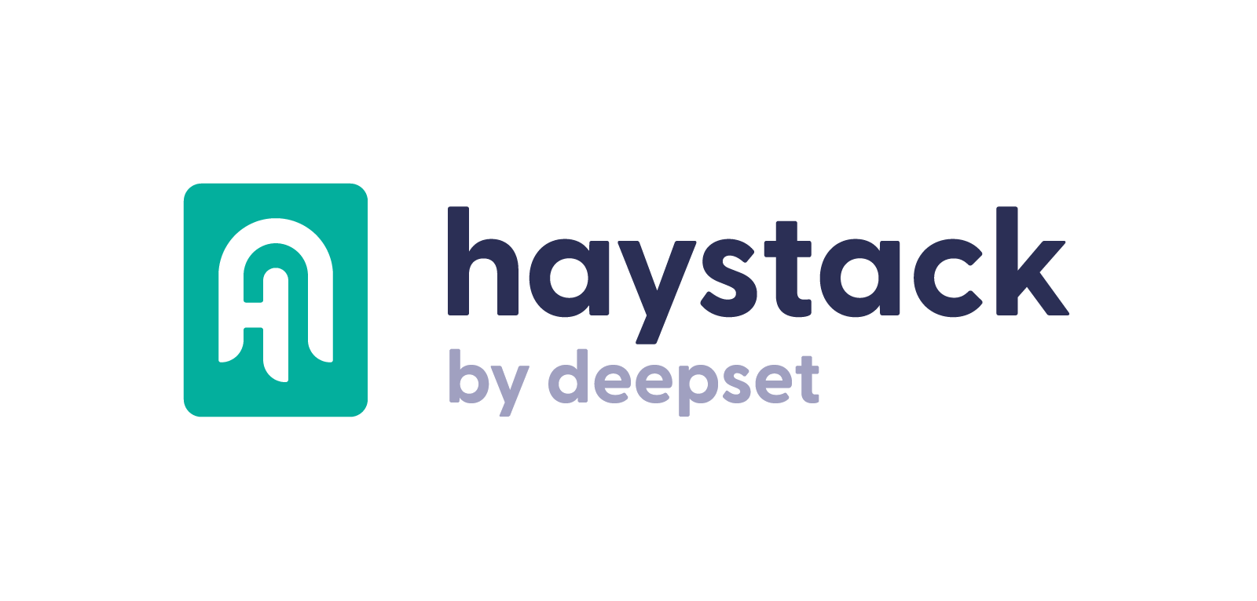
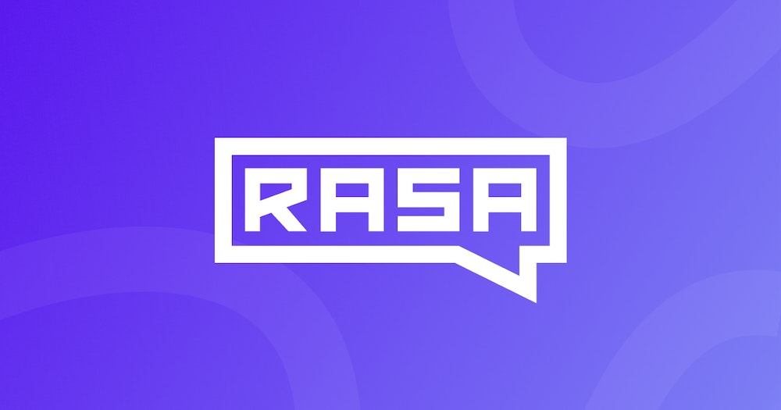
Onprem-bot
Haystack is an open-source framework for building search systems that work intelligently over large document collections.
Rasa Open Source is an open source conversational AI platform that allows you to understand and hold conversations, and connect to messaging channels and third party systems through a set of APIs.

Slide 6
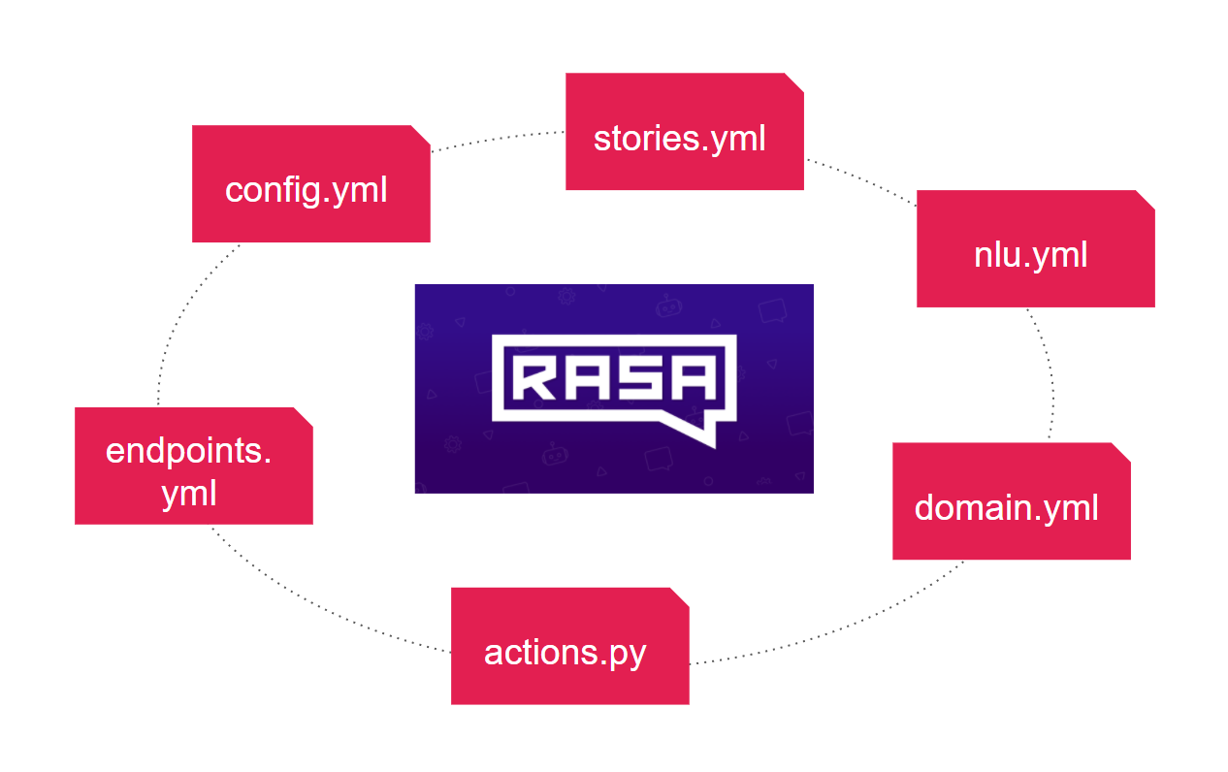
RASA

Slide 7
RASA AI
Pipelines
Policies
WhitespaceTokenizer
RegexFeaturizer
LexicalSyntacticFeaturizer
CountVectorsFeaturizer
DIETClassifier
FallbackClassifier
TEDPolicy
Memoization Policy
UnexpecTEDIntentPolicy
RulePolicy

Slide 8
Elasticsearch

Slide 9
ES design

Slide 10
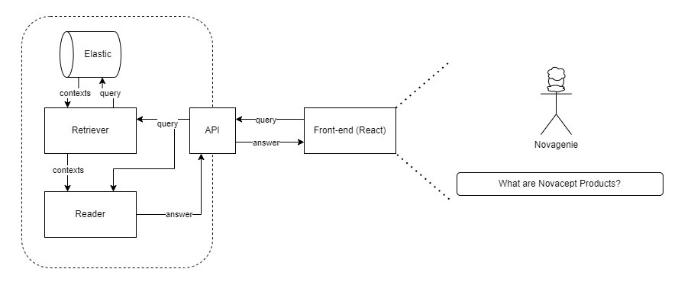
HAYSTACK

Slide 11
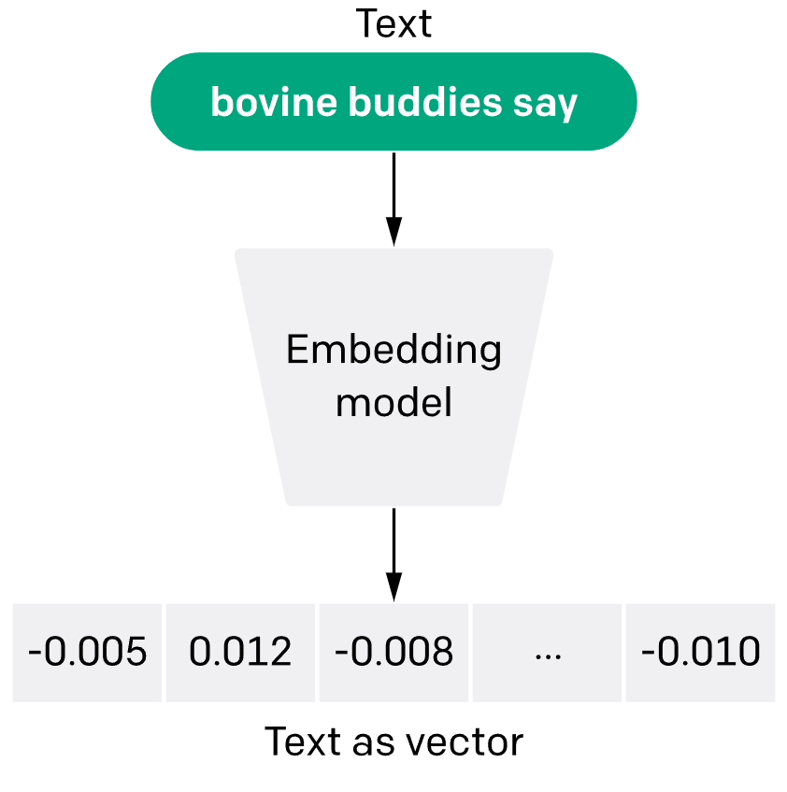
HAYSTACK AI
Hugging face Transformers
sentence-transformers/all-MiniLM-L6-v2

Slide 12
Streamlit

Slide 13
Docker

Slide 14
Use case

